Slide 1
SALES ANALYSIS DASHBOARD
Project by
Chanchal sharma

Slide 2
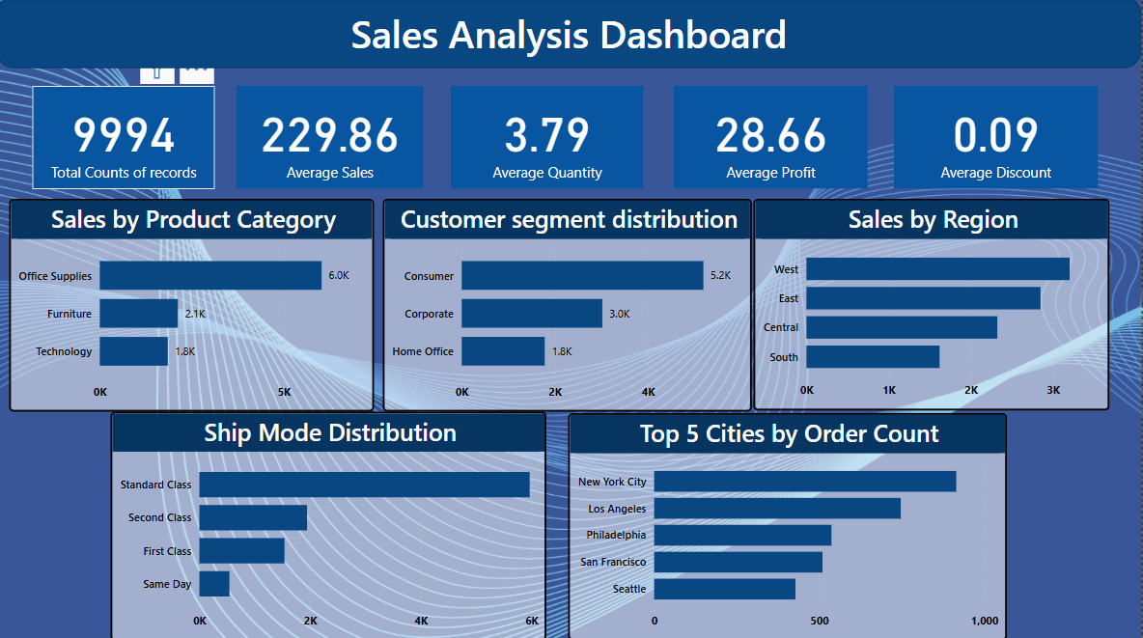

Slide 3
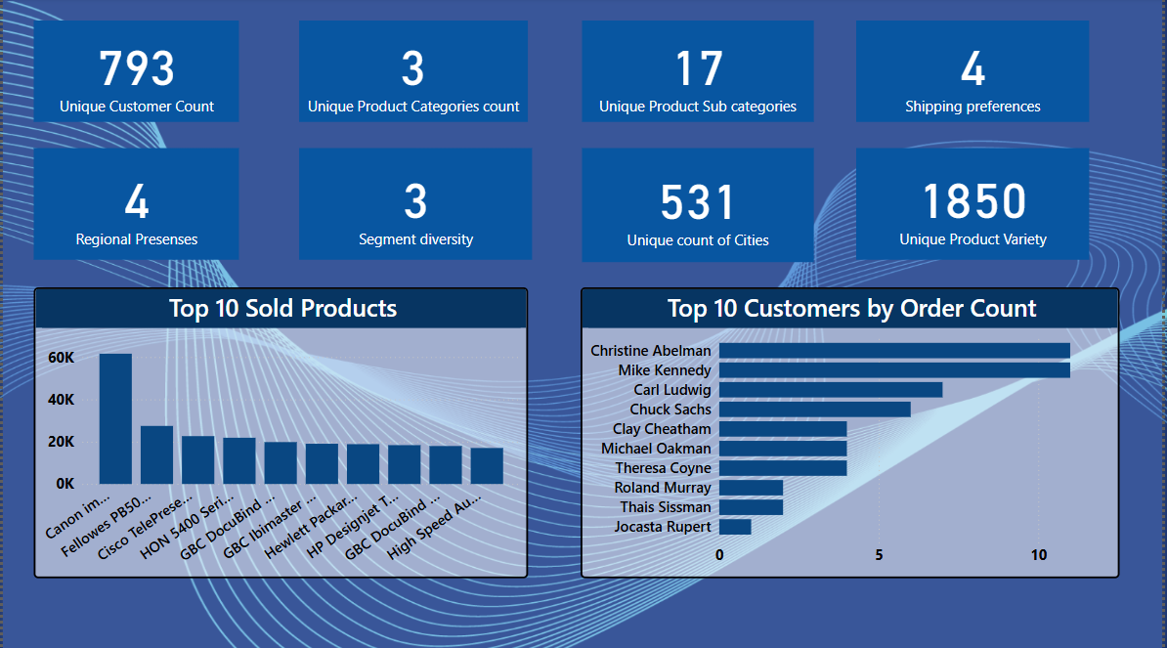

Slide 4
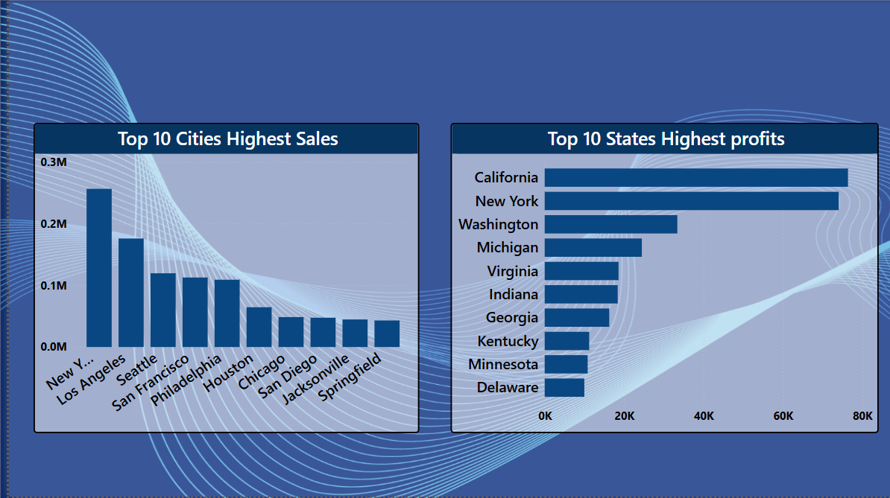

Slide 5
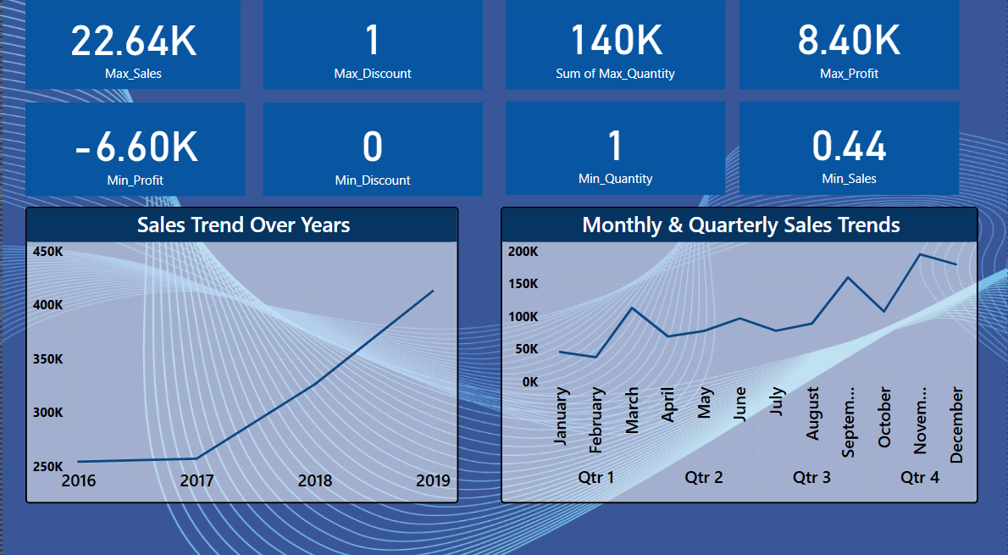

Slide 6
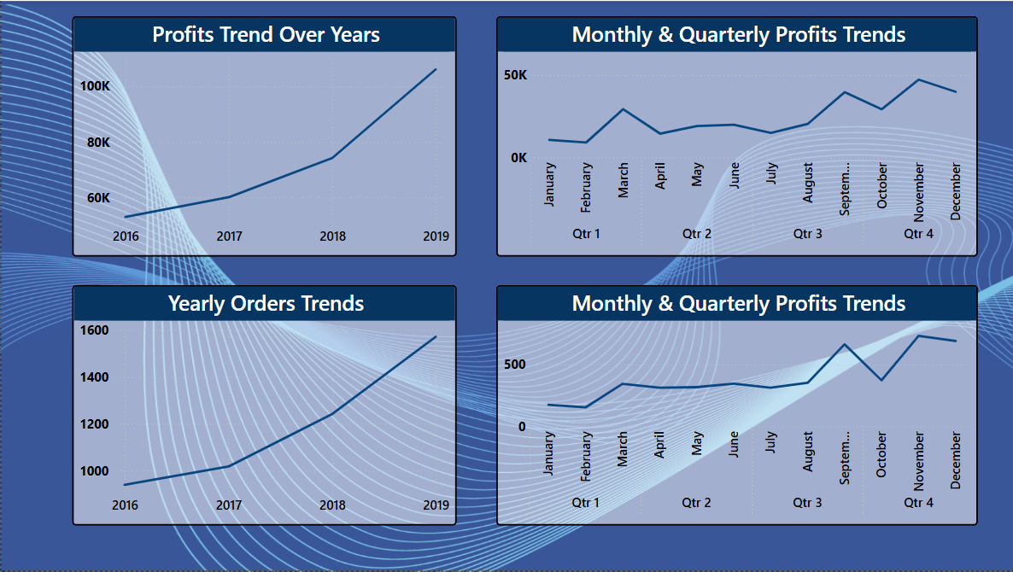

Slide 7
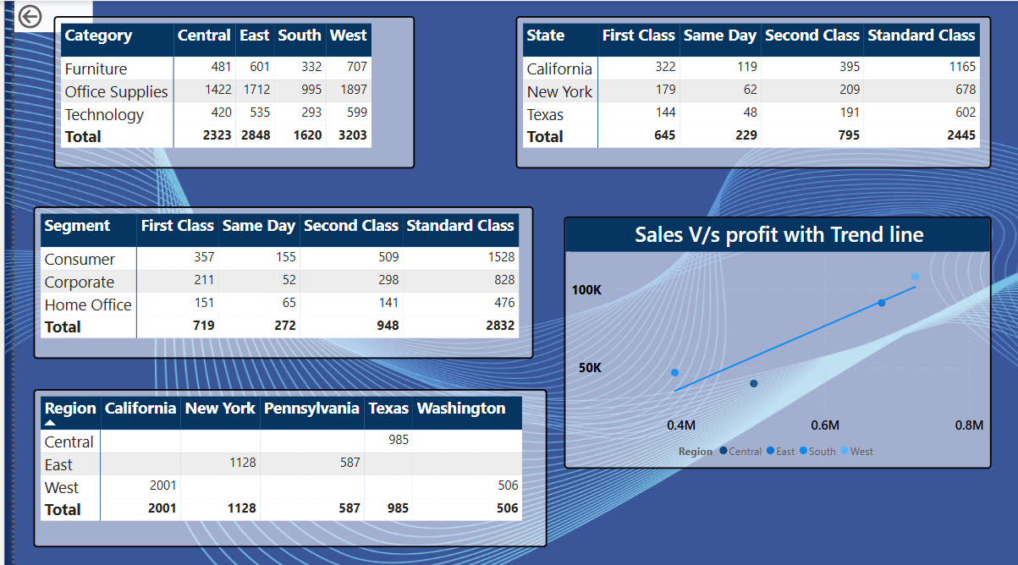

Slide 8
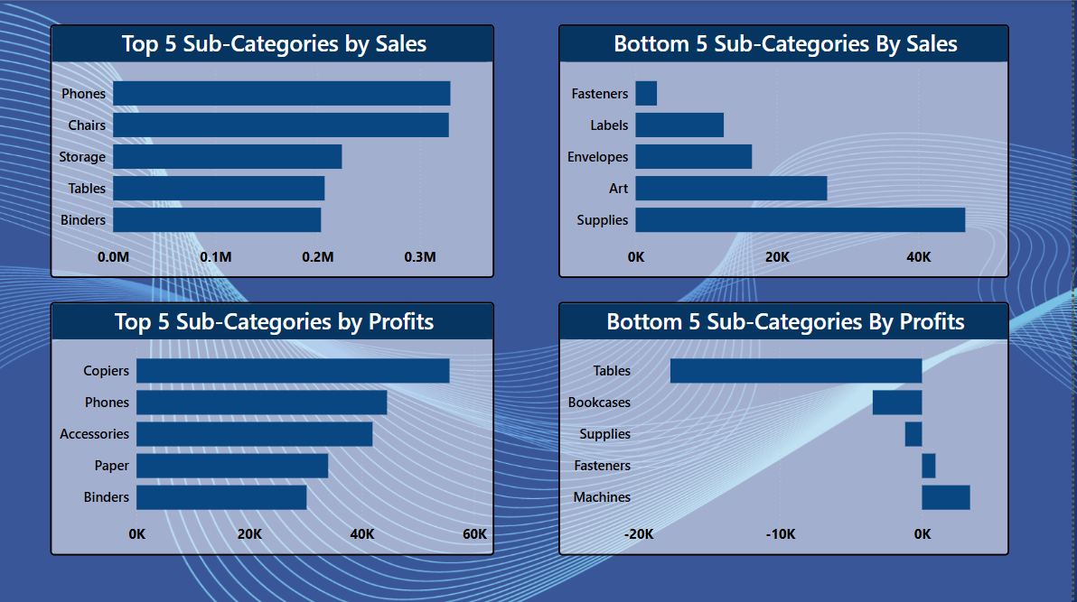

Slide 9
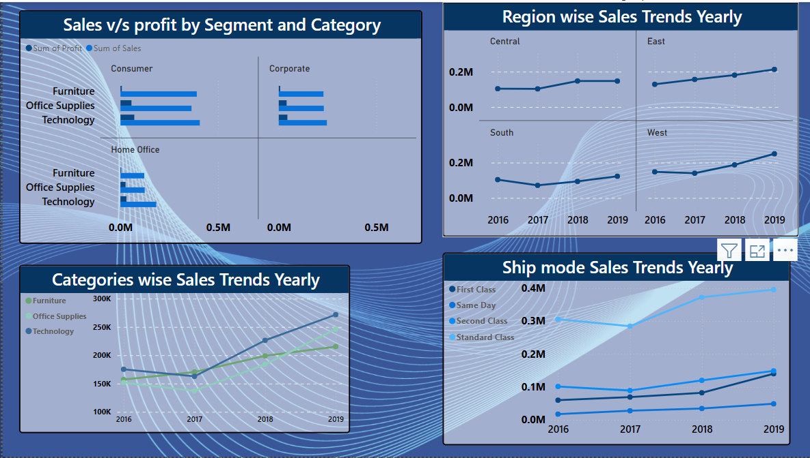

Slide 10
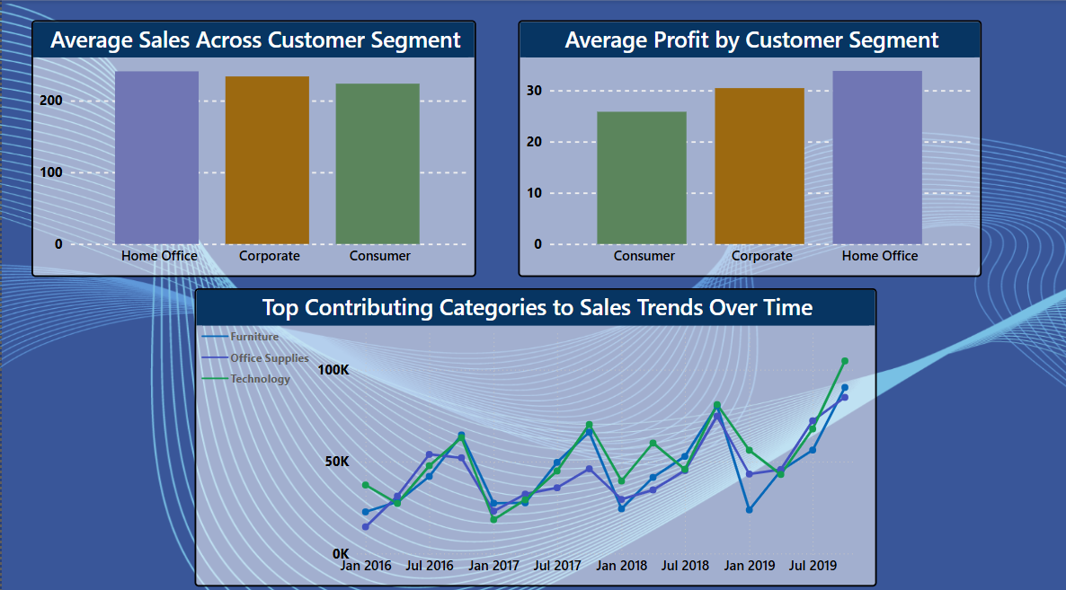

Slide 11
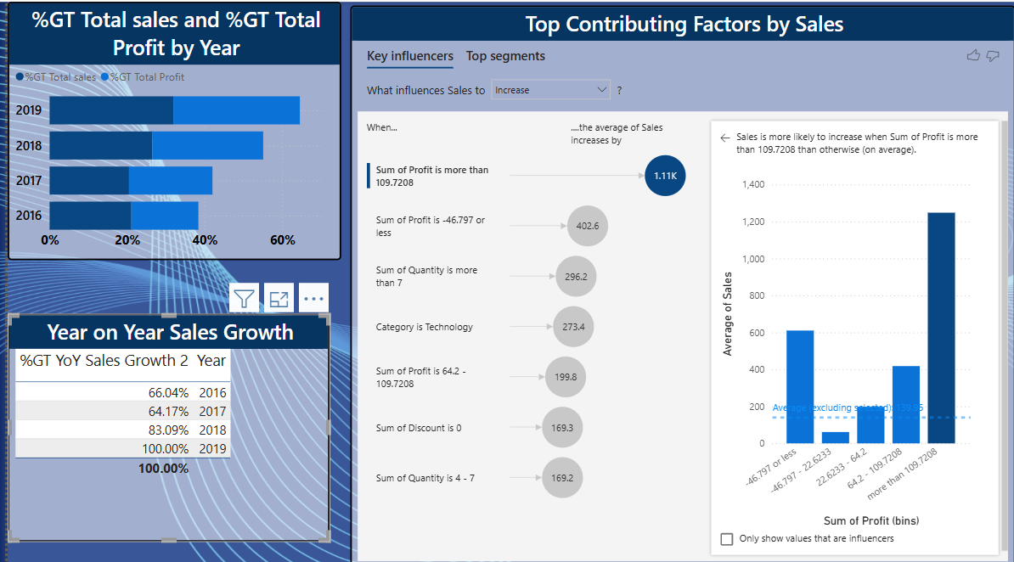

Slide 12
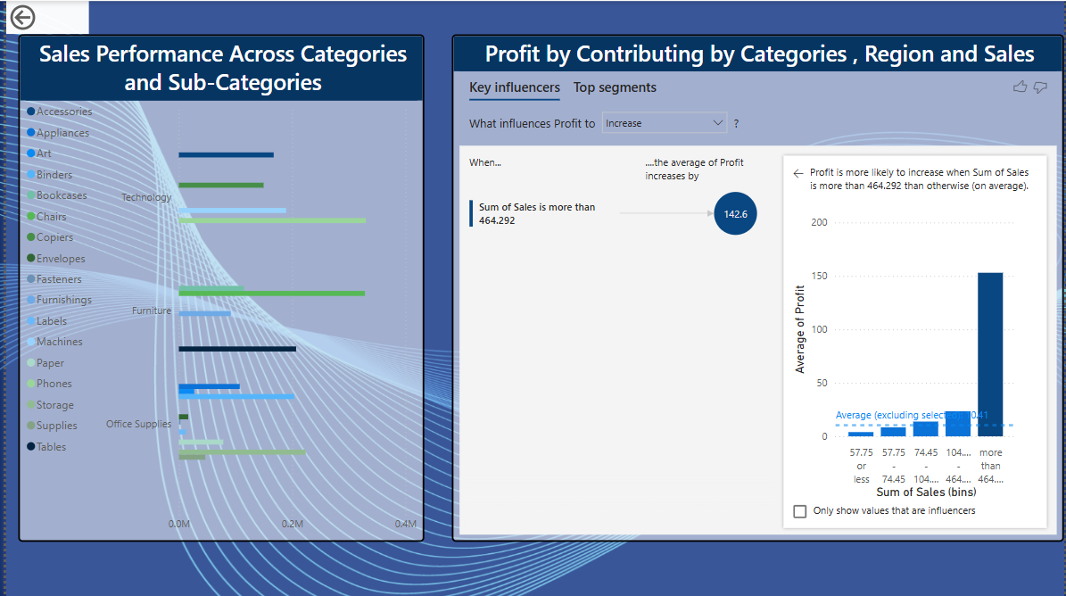

Slide 13
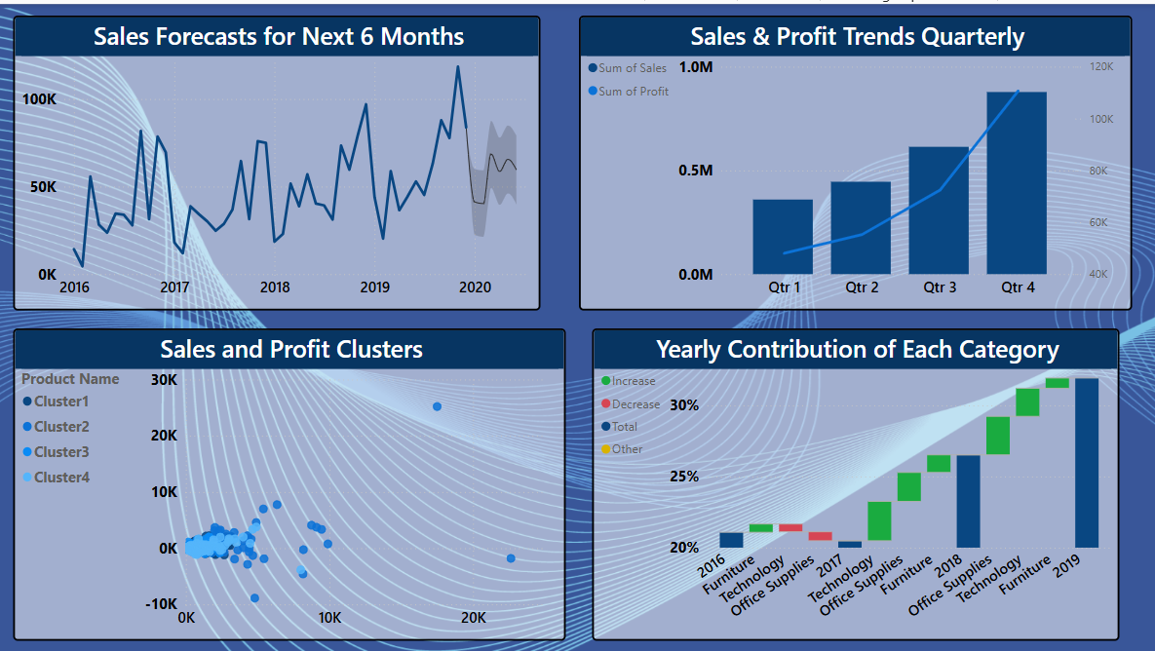

Slide 14
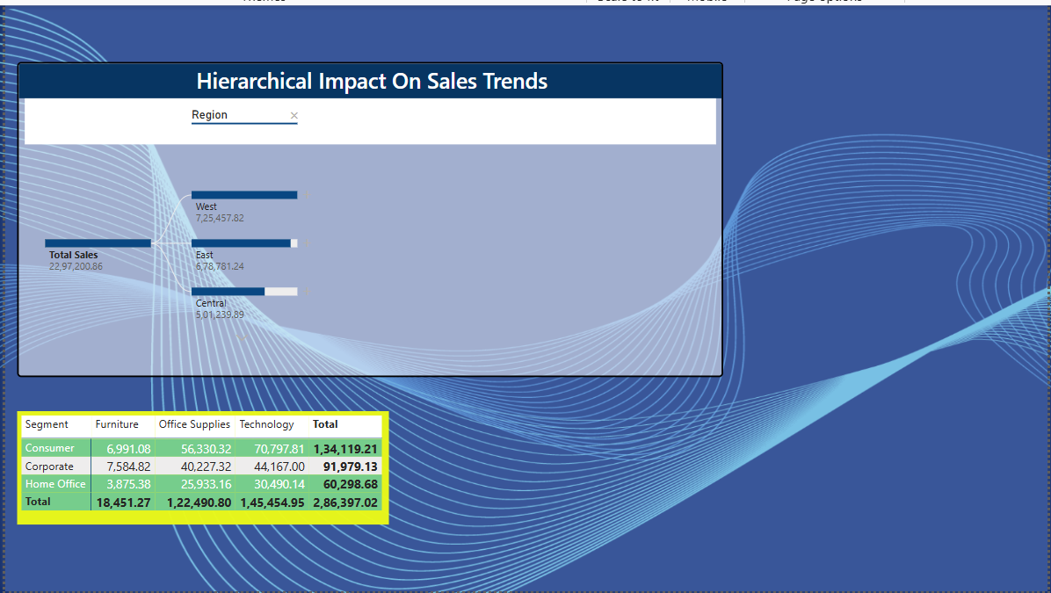

Slide 15
INSIGHTS
Customer & Sales Performance:-
The top 5 customers account for a major share of total revenue, highlighting a strong opportunity for relationship-based upselling.
Average sales per customer vary widely, suggesting a segmented approach in customer engagement could improve results.
Sales Trends Over Time:-
Monthly sales trends show clear peaks in the last quarter (Q4), indicating seasonal sales patterns tied to holidays and promotions.
Cumulative sales charts confirm consistent growth, with certain months showing steep increases.
Product & Category Insights:-
Technology and Office Supplies are the most profitable categories.
Top-selling products include phones, chairs, and storage equipment, with copiers leading in profit.
Some products have high sales but low profit, suggesting a need to review pricing or discount strategy.
.

Slide 16
Shipping Mode Analysis:-
Standard Class dominates order shipments, indicating customer preference for cost-effective delivery.
Same-Day delivery is underutilized but may represent a potential growth opportunity for premium customers.
Regional & Geographic Trends:-
The West and East regions generate the highest profits.
Sales are concentrated in cities like New York, Los Angeles, and San Francisco, as shown on the map.
Discount & Profit Relationship:-
A clear negative correlation between discount and profit: higher discounts often result in reduced profit margins.
Orders without discounts perform better in terms of profitability.
CONCLUSION
The Sales Analysis Dashboard provides a comprehensive and data-driven view of the business's performance across multiple dimensions—customer, time, product, region, and shipping.
Key conclusions include:
Strategic focus on top customers and high-margin products can drive revenue and profitability.
The impact of discounting needs to be carefully managed to protect profit margins.
Geographic sales trends and shipping mode usage offer opportunities to optimize logistics and target regional promotions.
.

Slide 17
Thank you

